Slide 1
TRAINITY INTERNSHIP PROGRAM TASK - 1 DATA SCIENCE PROCESS

Slide 2
STEPS INVOLVED
01
PLAN
04
ANALYZE
02
PREPARE
05
SHARE
03
PROCESS
06
ACT
A plan of act is necessary to begin with
Find patterns and trends
Prepare all the requirements as per the plan
Communicate the details with team
Process the data
Act accordingly.

Slide 3
REAL LIFE SCENARIOS
Two real-life examples where we use data analytics unknowingly are:
Setting your finger/face as your password
Healthcare – Identifying Diseases and Alpha Fold

Slide 4
01
Biometrics
Face/Fingerprint password to phone

Slide 5
DA in BIOMETRICS
Ever wondered why did your mobile ask you to catch the phone for 10 seconds or asked you to tap more than once and sometimes also makes you to tap with all parts of your finger. Lets understand why do we have to do that exactly.

Slide 6
STEPS
Steps Involved in Biometric Security of a Mobile of Data Analytics
Plan | Based on the method we choose the operating system in the mobile will decide what data do we need (face structure/fingerprint pattern) and what resources should be used (camera/fingerprint sensor). Here initially the data is the choice.
Prepare | Once chosen the OS checks if it is beyond the limit or is it still in the limit (face: 1, fingerprint: 3) and all the other requirements to complete the process.
Process | Then if everything is verified it goes to the next step where it collects the fingerprint from every corner or the face for about 10 seconds. This is the actual data which is analysed.
Analyse | Then, the data collected is analysed by breaking it down to small parts to find the pattern in the fingerprint it reacieved or the face structure by breaking the 10 sec into various pictures.
Share | Then, the data is shared with the kernel for storing it as the password. Here, since the team is the OS and its components
Act | Finally we can open our mobile using our desired mode.

Slide 7
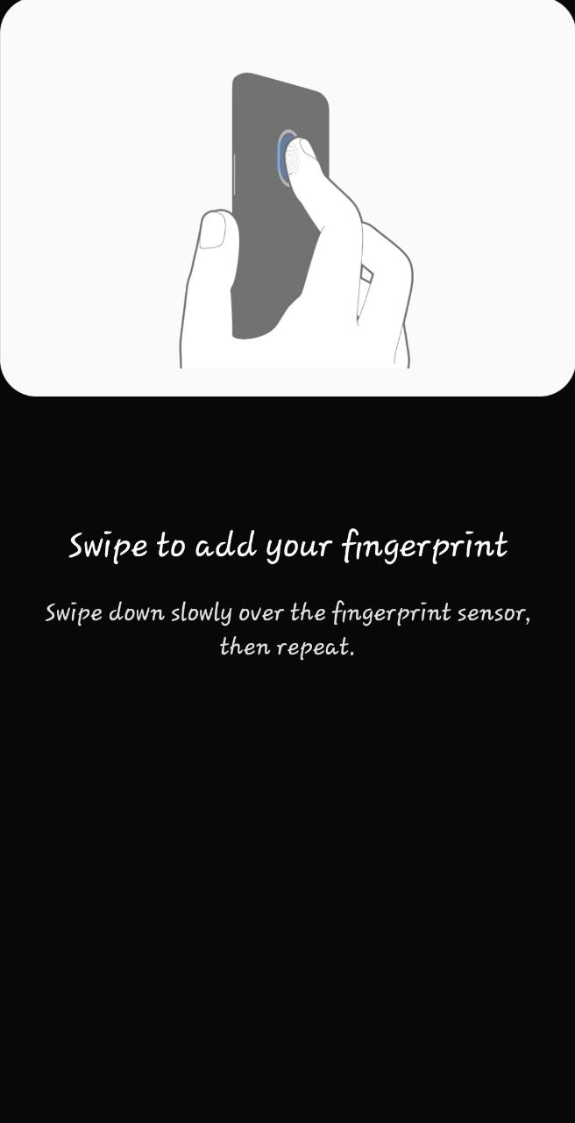
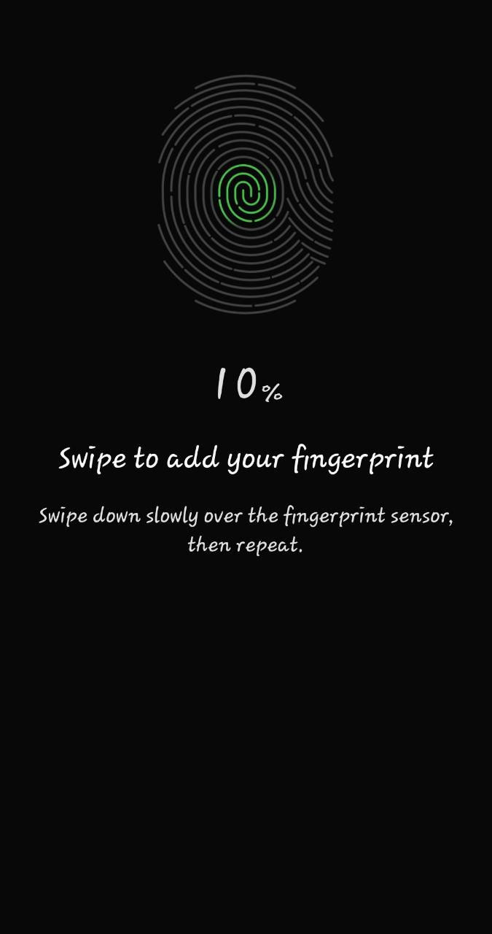
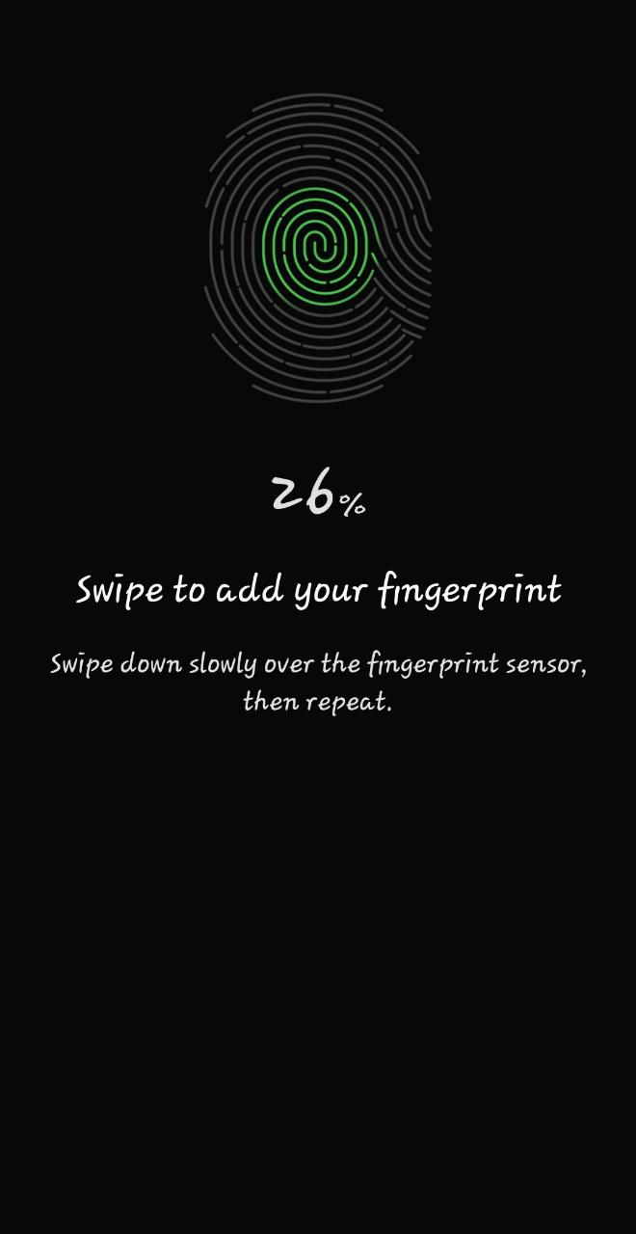
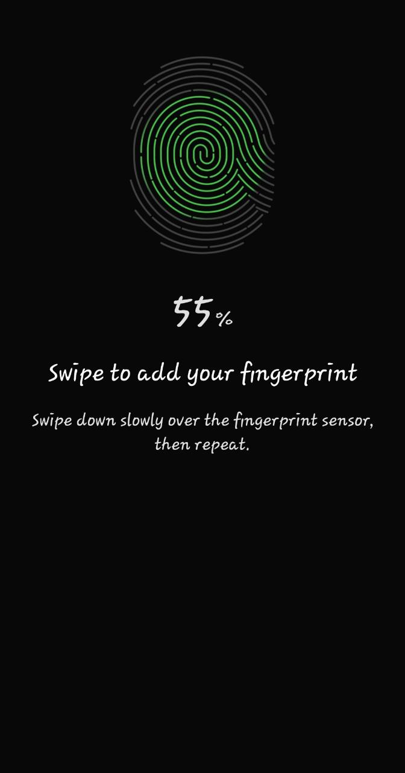
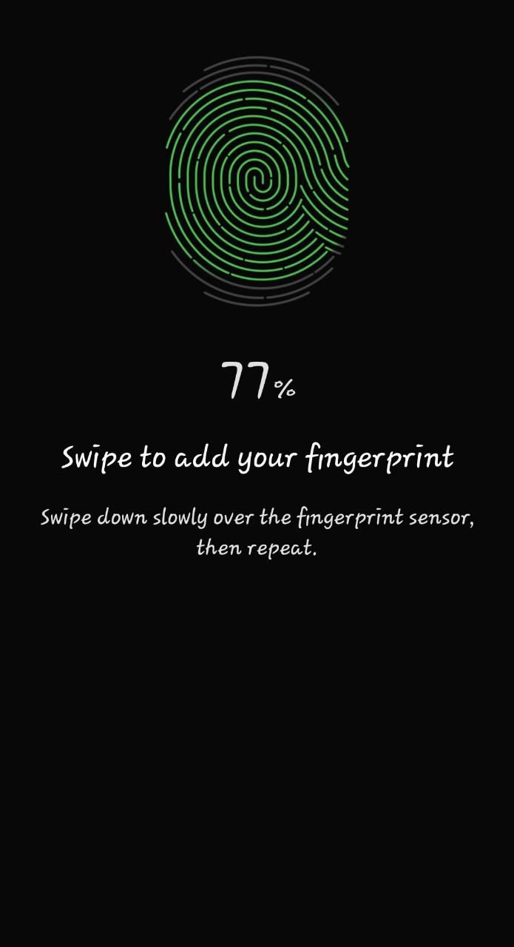
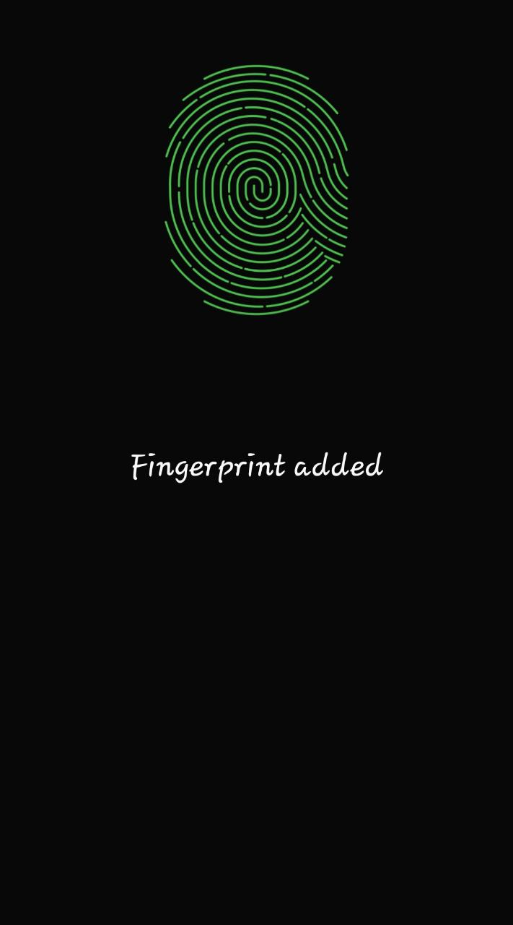
This is how my phone does it
We can see a step by step approach here since the Processor is Processing the input given to it using data analytics steps to find patterns and recognise the fingerprint using that pattern later on.

Slide 8
02
Healthcare
Finding out diseases and Invention of Alpha Fold

Slide 9
DA in HEALTHCARE
Researchers have found a way to find the patterns in examining the disease in people by inputting the data of infected people into a model and training it.
Alpha Fold is an innovation of next generation which is based on Data Analytics. Alpha Fold is a model that predicts the protein structure based on amino acids. So that’s something we can leverage in the future not only for the health industry, not only for detecting diseases.

Slide 10
STEPS
Steps Involved in Disease Detection of Data Analytics
Plan | Here we decide which disease are we going to detect.
Prepare | We then ready the information and data abt people who are infected with that disease and its symptoms etc to feed it as an input
Process | The validated data is then fed to model which is processed in order to train the model over that data
Analyse | Then all the patterns and trends in that data are found and learnt by the system over time.
Share | Then that data is shared
Act | Finally, the required actions are taken.

Slide 11
Alpha Fold is Protein Structure which is an AI generated structure using DeepMind which is an advanced application of Data Analytics and Machine Learning Concepts.
Some other real life examples are: Automatic Weather Forecasting, Self Driving Cars etc are some other examples which work using Data Analytics as a base.

Slide 12
YOU
THANK

